Slide 1
Exploratory Data Analysis of Large-Scale Industry Performance Dataset Using Univariate, Bivariate, and Multivariate Statistical Techniques
Submitted By:
V.Satish
Data Analytics Internship
NextHikes IT Solutions
L-110226-W2PM-B15

Slide 2
Project Objective
The objective of this project is to perform Exploratory Data Analysis (EDA) on an industry performance dataset containing 15,000 records and 12 variables.
Key Goals
Understand business data
Analyze company performance
Detect outliers
Study variable relationships
Generate business insights

Slide 3
Dataset Overview
Feature | Description
Rows | 15,000
Columns | 12
Data Types | Numerical, Categorical, Date
Features
Industry
Country
Employee Count
Revenue
Profit Margin
Customer Count
Market Rating
Region

Slide 4
Libraries Used
Python Libraries
Pandas
NumPy
Matplotlib
Seaborn
Purpose
Data Cleaning
Statistical Analysis
Visualization
Business Insights

Slide 5
Data Understanding & Cleaning
Activities Performed
Data loading
Data type verification
Missing value analysis
Duplicate record check
Findings
No missing values found
No duplicate records found
Dataset ready for analysis

Slide 6
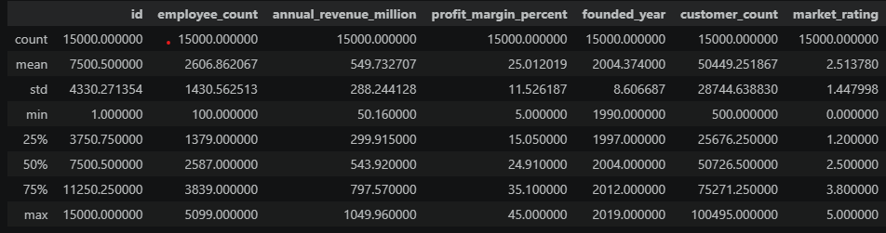
Univariate Analysis
Numerical Variables Analyzed
Employee Count
Annual Revenue
Profit Margin
Customer Count
Market Rating
Statistical Measures
Mean
Median
Standard Deviation
Min & Max

Slide 7
Distribution Analysis
Skewness Analysis
Positive skewness observed in:
Revenue
Employee Count
Customer Count
Interpretation
Most companies operate at medium scale while a small number dominate the market.

Slide 8
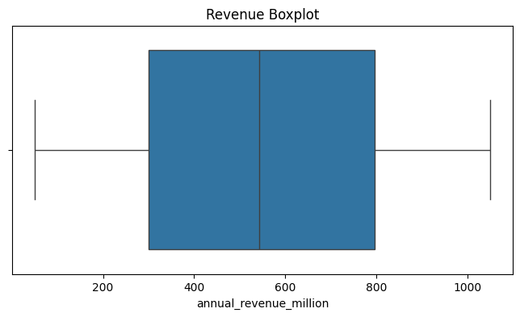
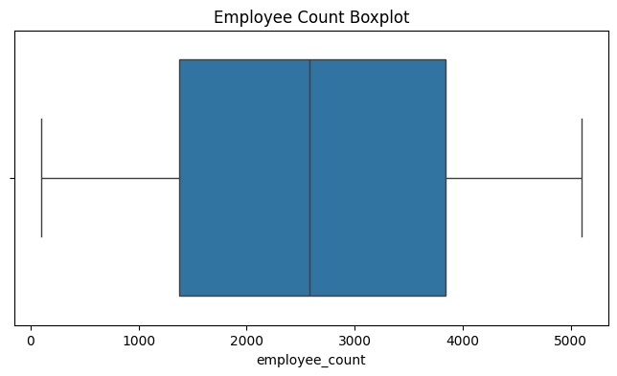
Outlier Detection
Methods Used
Boxplots
IQR Method
Findings
Revenue outliers identified
Employee count outliers identified
Customer count outliers identified
Decision
Outliers retained because they represent genuine large-scale enterprises.

Slide 9
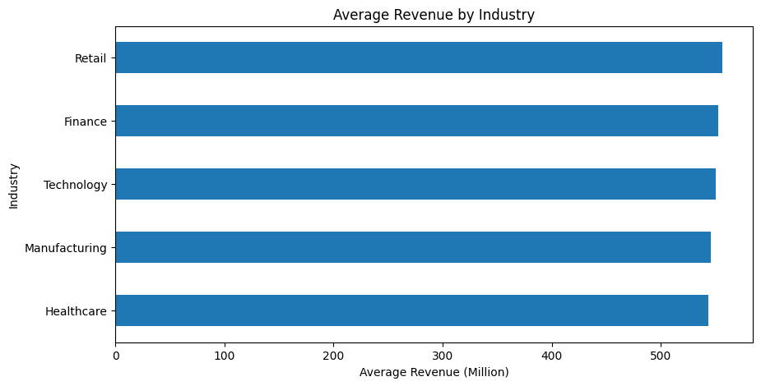
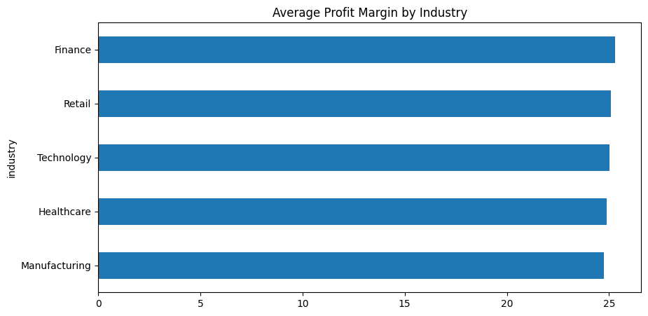
Bivariate Analysis
To analyze relationships between two variables.
Examples
Industry vs Revenue
Industry vs Profit Margin
Country vs Market Rating
Region vs Revenue

Slide 10
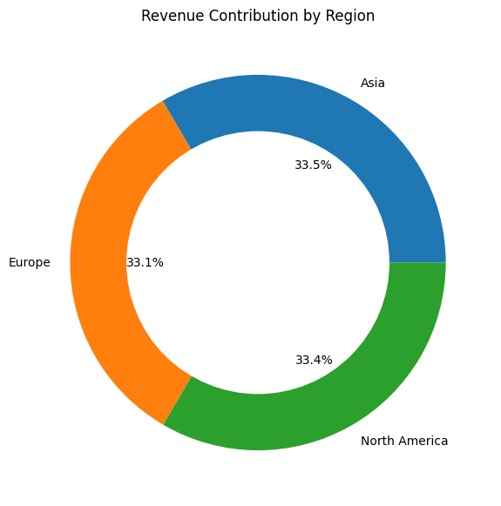
Bivariate Analysis Findings
Key Findings
Technology industry generated highest revenue.
Retail industry served largest customer base.
Market ratings varied across countries.
Revenue differed across regions.

Slide 11
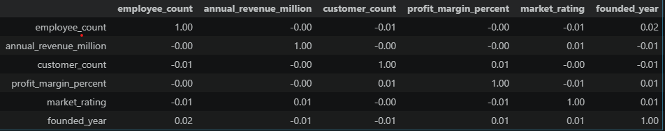
Correlation Analysis
To understand relationships among numerical variables.
Findings
Strong Positive Relationship:
Employee Count ↔ Revenue
Customer Count ↔ Revenue
Moderate Relationship:
Profit Margin ↔ Market Rating
Weak Relationship:
Founded Year ↔ Revenue

Slide 12
Multivariate Analysis
Analyze interactions among multiple variables.
Scenarios Studied
Industry × Revenue × Employee Count
Region × Profit Margin × Market Rating
Country × Customer Count × Revenue

Slide 13
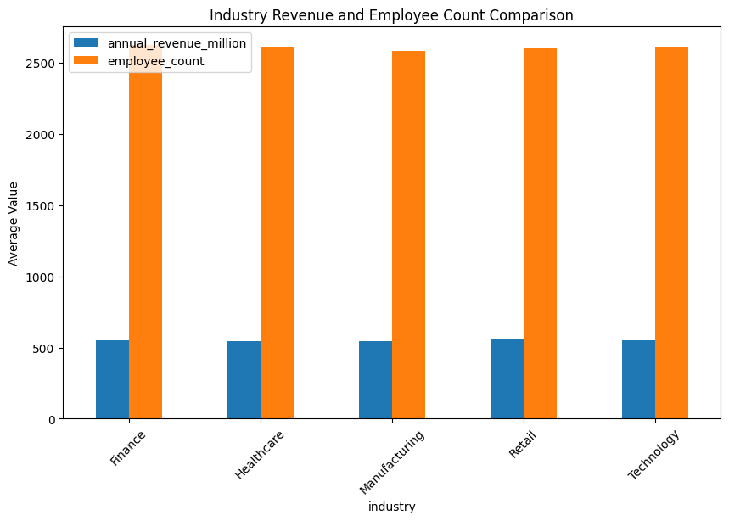
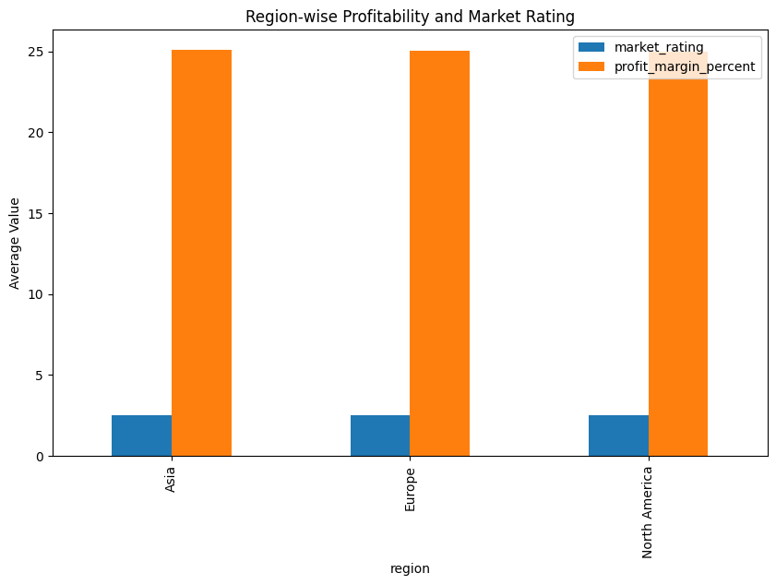
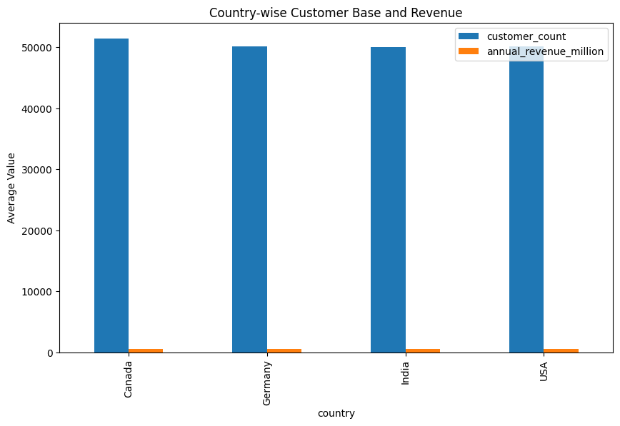
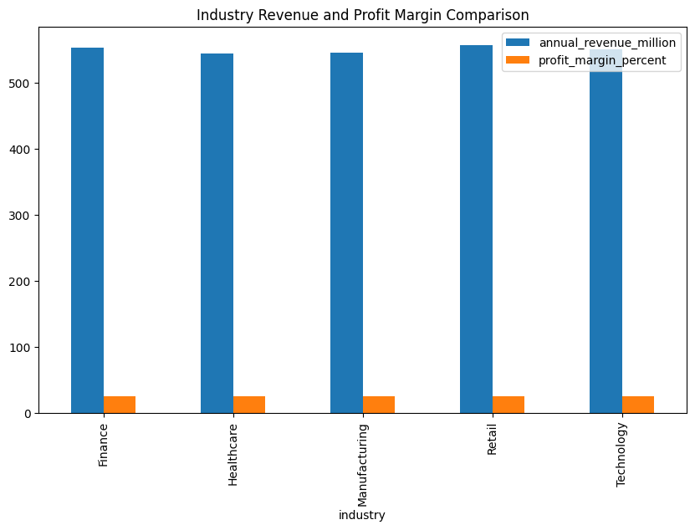
Multivariate Analysis

Slide 14
Multivariate Analysis
Key Findings
Technology companies generated highest revenue.
Manufacturing companies maintained larger workforces.
Customer acquisition strongly influenced revenue.
Regional factors affected profitability.

Slide 15
Business Insights
Major Insights
Technology sector dominated revenue generation.
Retail sector handled highest customer volume.
Revenue increased with employee count.
Customer count strongly impacted revenue.
North America showed strong market ratings.
Large enterprises contributed significantly to revenue.
Profitability varied across industries.
Revenue distribution was positively skewed.
Outliers represented real business entities.
Business performance varied across regions.

Slide 16
Conclusion
Successfully performed EDA on 15,000 records.
Conducted Univariate, Bivariate and Multivariate Analysis.
Identified revenue and workforce patterns.
Detected and analyzed outliers.
Generated actionable business insights.
Business Value
The analysis supports:
Business Intelligence
Industry Benchmarking
Revenue Forecasting
Strategic Decision-Making

